Slide 1
Data Scientists Salary Prediction
Carson Brower and Garrett Ward

Slide 2
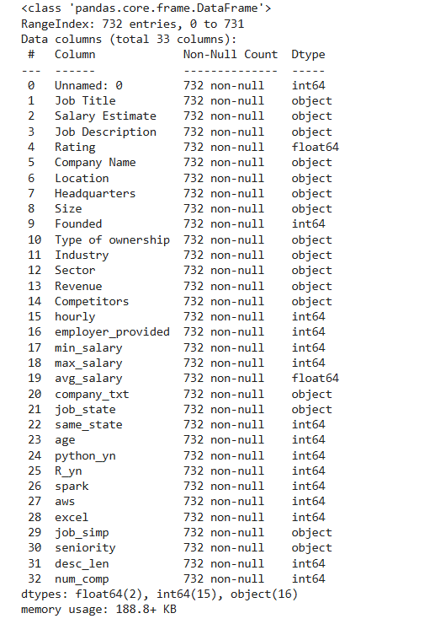
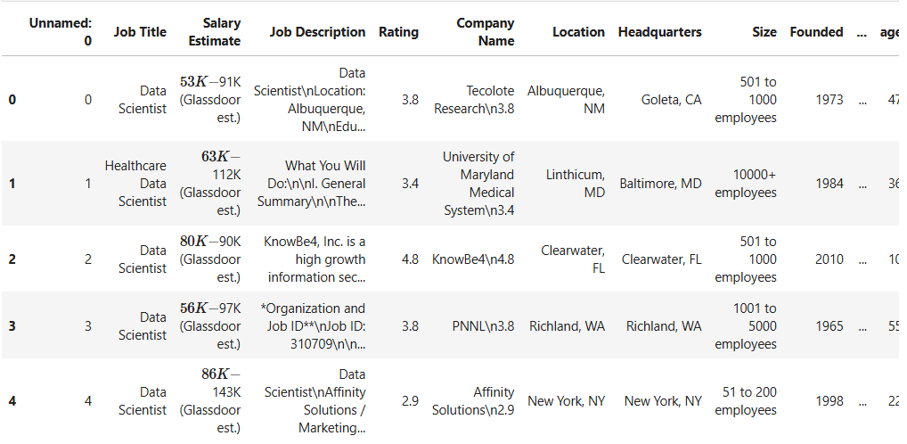
Background
732 Entries with 32 Columns
No Missing Values or Data
Variable Types within our Data were Int, object, and float
Variable Age meant Company Age not Employee Age
Carson

Slide 3
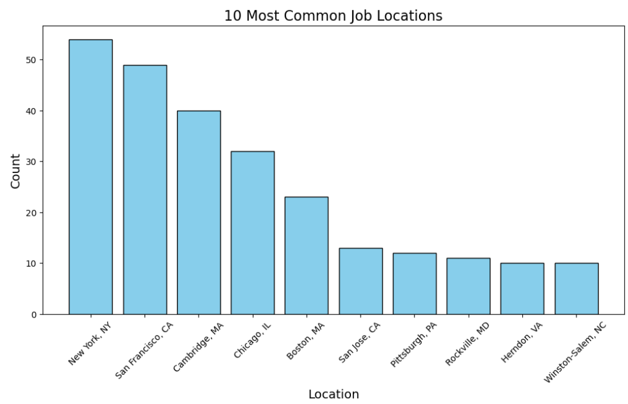
Locations
Garrett

Slide 4
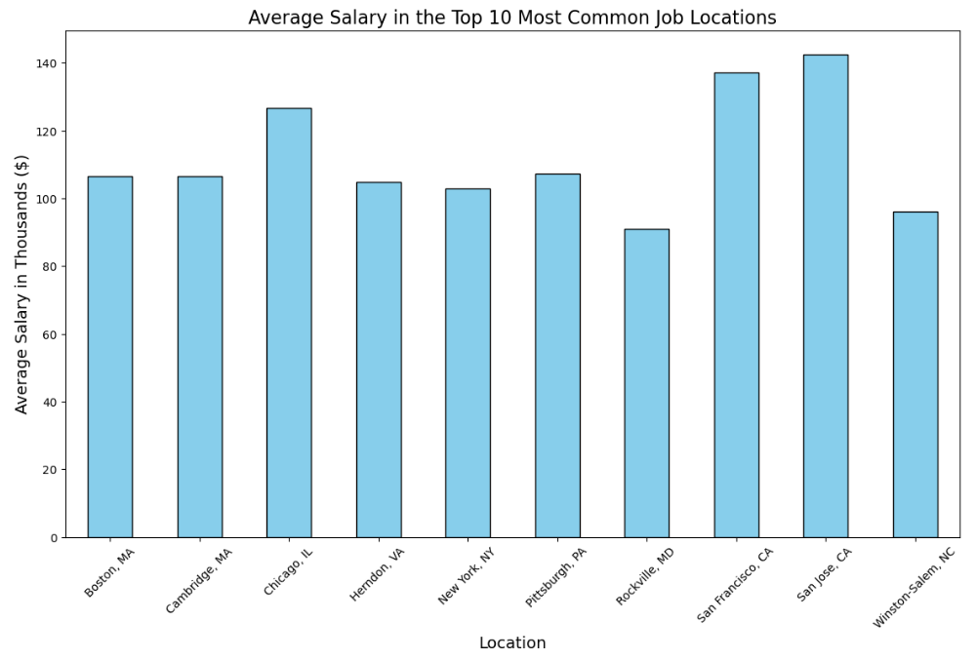
Salary by Location
Carson

Slide 5
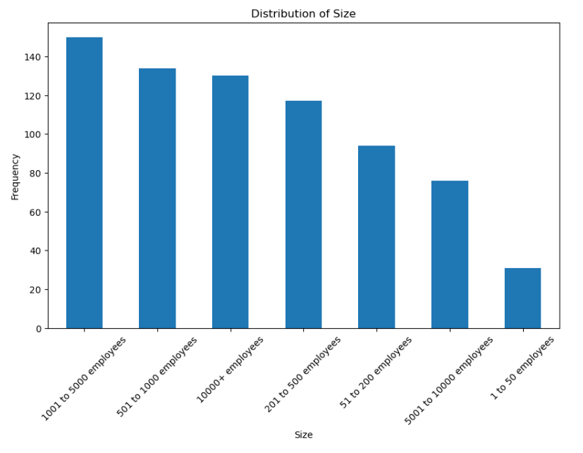
Company Size
Garrett

Slide 6
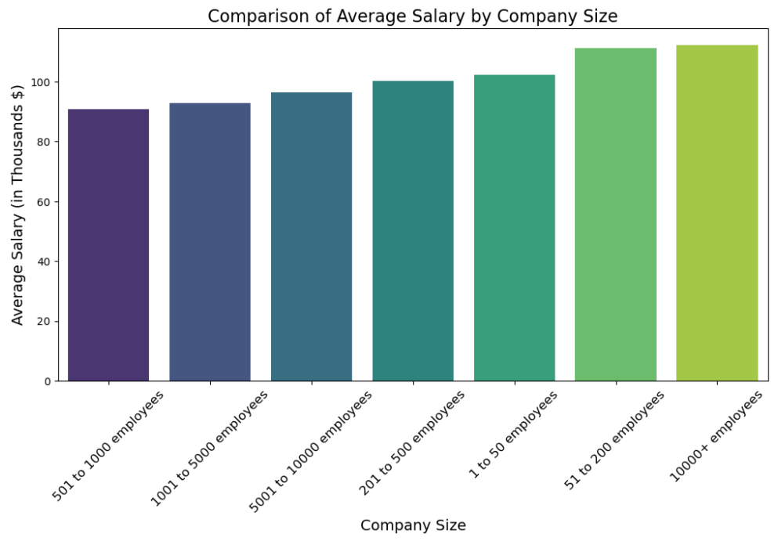
Size vs Salary
Carson

Slide 7
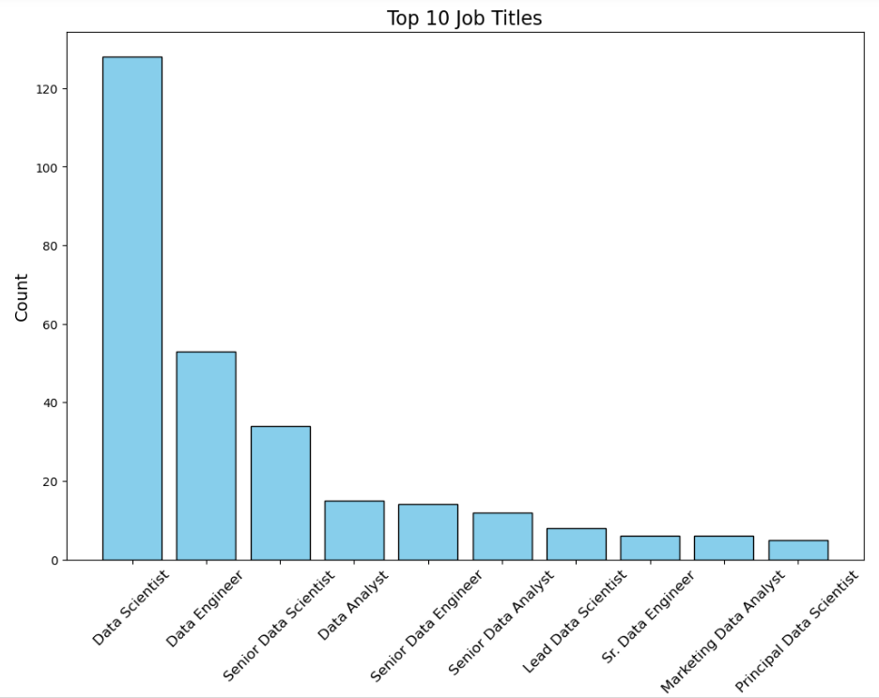
Job Titles
Garrett

Slide 8
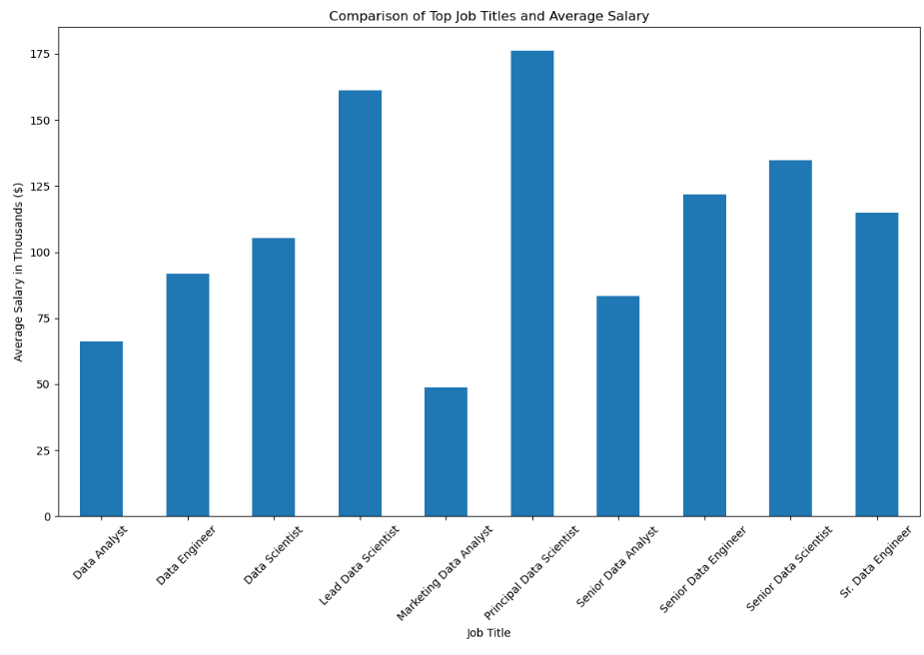
Top Jobs Salaries
Carson

Slide 9
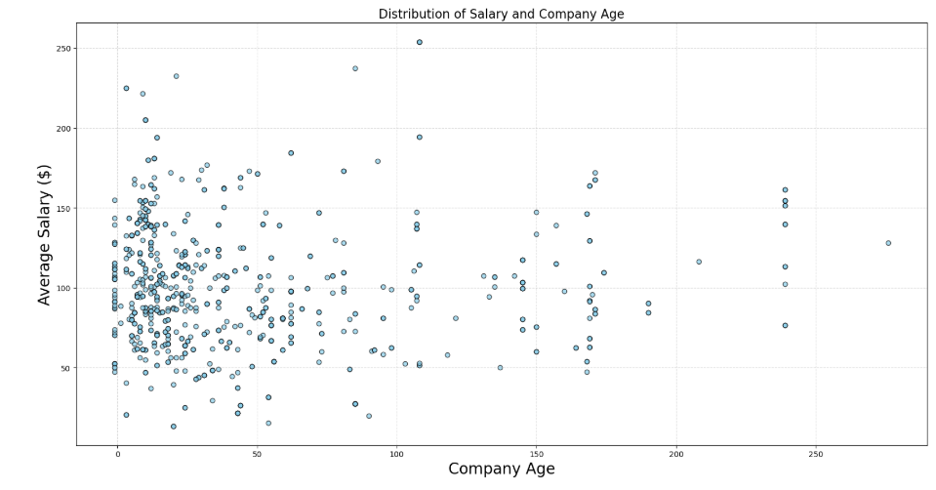
Organization's Age effect on Avg Salary
Garrett

Slide 10
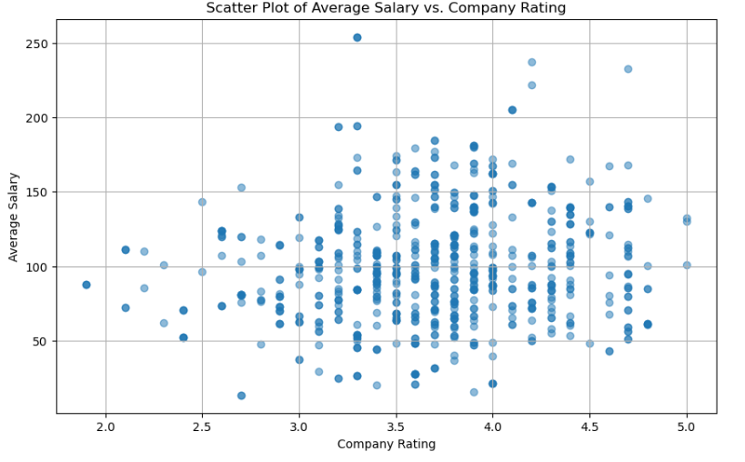
Rating and Salary
Carson

Slide 11
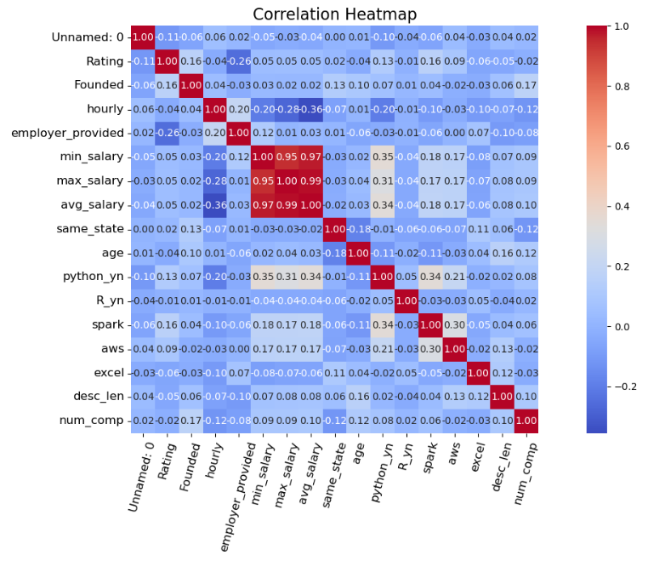
Correlation Heatmap
Garrett

Slide 12
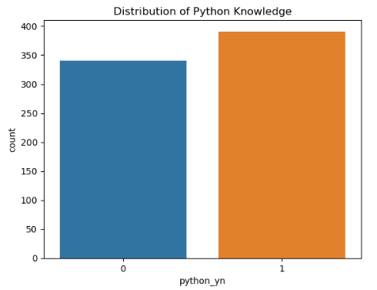
Scientists Python Knowledge
Carson

Slide 13
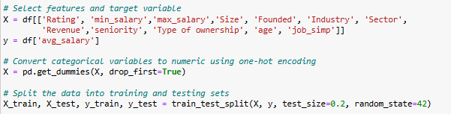


Linear Regression Model
Carson

Slide 14
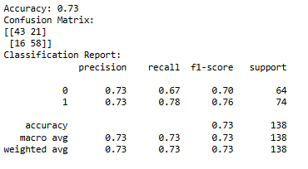
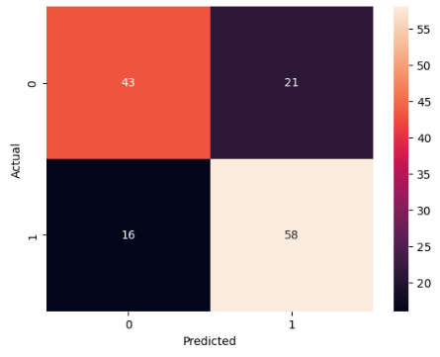
Logistic Regression Model
Garrett

Slide 15

Problems
Invalid entries in company size
Problematic entry from one company
Output errors when running Linear regression
Garrett

Slide 16

Data Limitations
Our model predicted more false positives than we hoped
Limited Sample Size
Small number of variables the truly correlated
Linear gave more accurate results than Logistic
Carson

Slide 17

Improvements for Future Work
Resampling Techniques
Adding more variables and collecting more results from Data Scientists
Managing Outliers and Evaluating more data
Better improvements and validation from the two models
Carson

Slide 18
Conclusion
Too many false positives but linear regression data turned out to be accurate with a mean square error of 8.32 and a R Square of 0.995 with an accuracy score of approximately 73%
Majority of the variables had direct correlation to the salaries
We were able to produce a model that can accurately predict the data scientist salary
Models were good but there still can be improvements
Garrett

